Slide 1
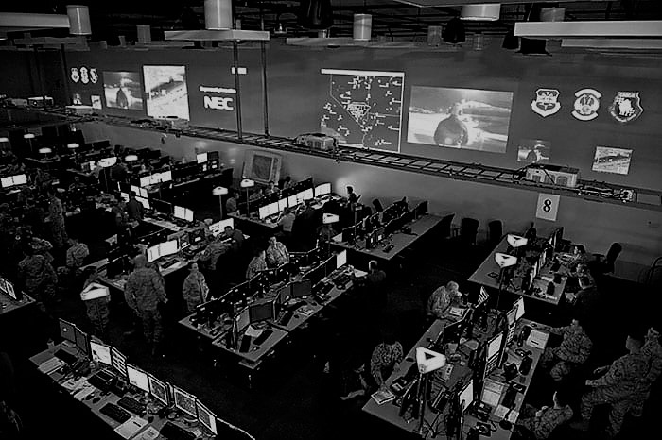
IT Project Review 1
SOFTWARS 23 Mar 20

Slide 2
Project Overview
SOFTWARS’ aim is to foster a greater understanding of systems and simulation by producing the highest quality of research and code.
We will produce a deliverable in Unity that accurately injects algorithmic behaviour traffic into any number of simulators connected to the network (via DIS gateway).

Slide 3

Contents
About the team
01
TASKS & TIMELINES
03
ARTEFACTS
04
THE PROJECT
02

Slide 4

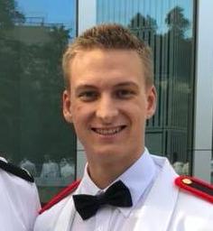
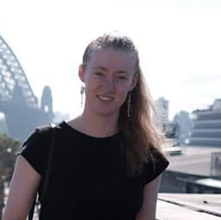

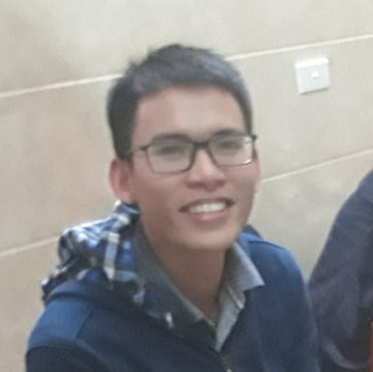
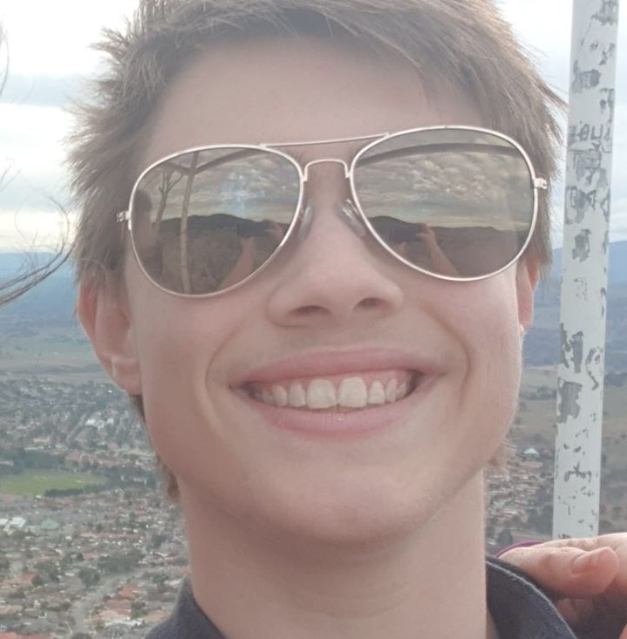
About Us
About the team
Our Client
Our Team
Bridget Free
Tate Waters
Project Manager and Documentation
External Liaison and Client Manager
Dr Sura De Silva
Terra Schwartz
Do Tran
Andrew Russell
Lead Technical Developer
Assistant Technical Developer and Testing

Slide 5
Team Communication
Internal Team Communications:
Main comms over Facebook messenger
Allows for quick and easy responses
Jira used for Task and Project Management with the team informed of all updates
All key artefacts on Github including confirmed meeting notes and client minutes
External Team Communications:
Email client for all important communications – includes meeting agenda
Meetings now conducted over GoToMeeting due to COVID-19

Slide 6
Communication Strategies and Weaknesses
Verbal Communication Strategies
Written Strategies
Any updates to both Github and Jira are also reiterated in the group chat as a formatted update e.g. “I just upload ____ to ____. This does ____.”
This ensures that all key communication is structured.
Meeting notes are formatted with clear headings and are edited by all team methods before final upload.
Oral Strategies
During meetings we establish clear agendas that are adhered to.
Weaknesses
minor weakness with the first software program so changed over to Jira
struggled with not staying on track during key team meetings and therefore established clear agendas that are briefed and agreed upon before meetings
we also do not allow phones to be out during team and client meetings to ensure distractions are minimized

Slide 7
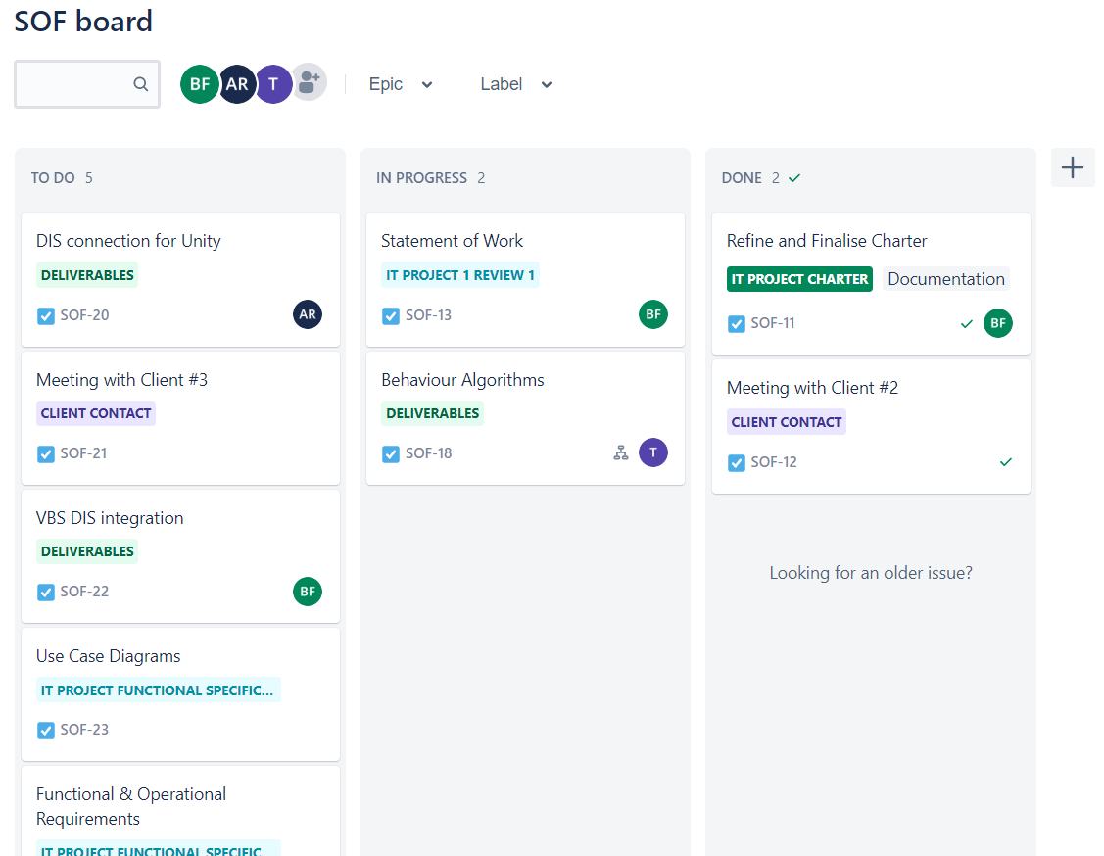
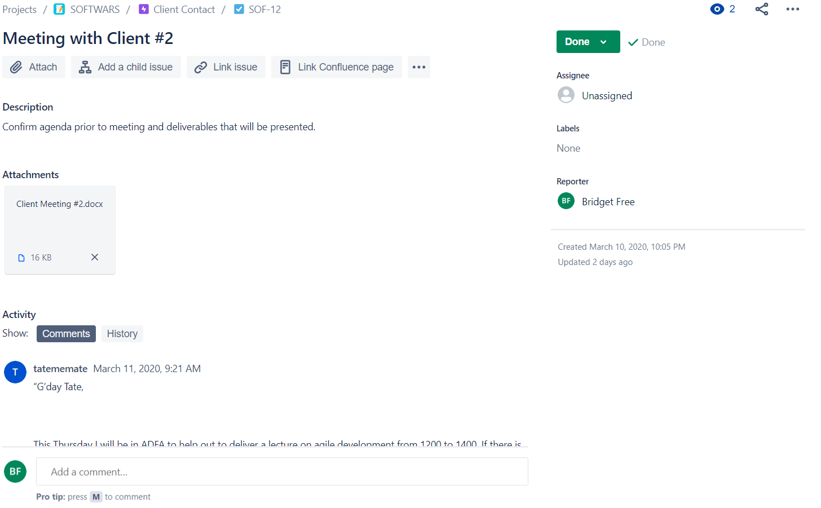

Slide 8
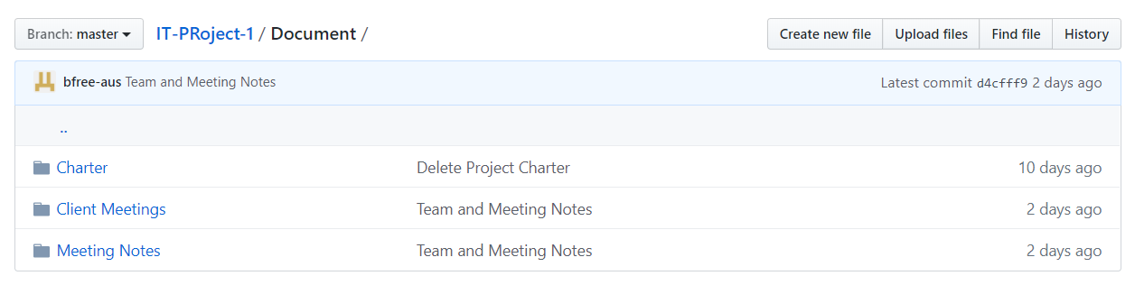
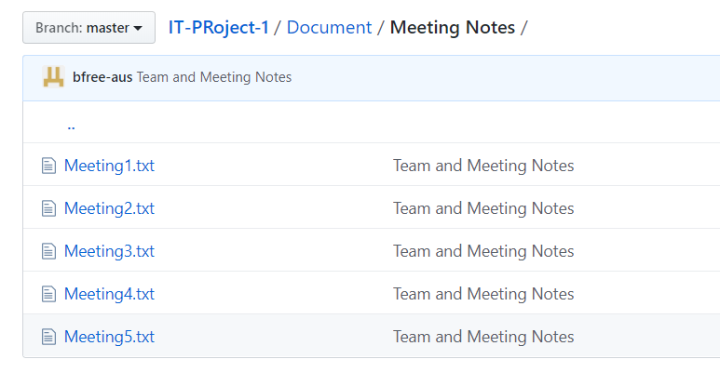
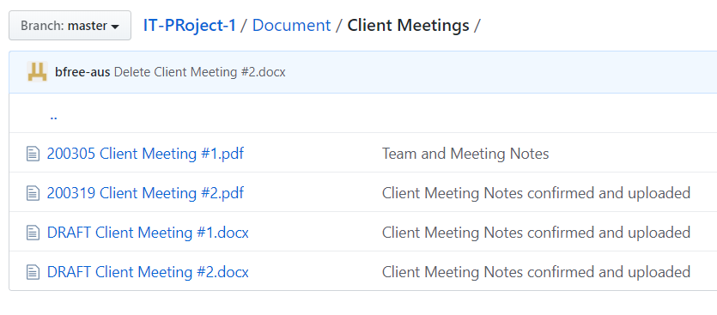

Slide 9
Background Information and Scope
Scope
Create “pattern of life” algorithmic behaviour in Unity, focusing on entity state PDUs, that is injected through DIS middleware into one or more connected, distinct simulators.
Background Information
There are various established frameworks including HLA and DIS. We will work on at least 2 behaviour models of varying fidelity levels to populate connected simulators to improve “real word” simulation.

Slide 10
Key Deliverables
Overall tasks that must be completed.
Visualisation environment that can use broadcast PDU entity data to update in real time
Third Deliverable
3
Configured middleware that can encode and inject DIS traffic and broadcast across network
Second Deliverable
2
1
Created multiple simulated behaviour models in Unity
First Deliverable
SOFTWARS
10

Slide 11
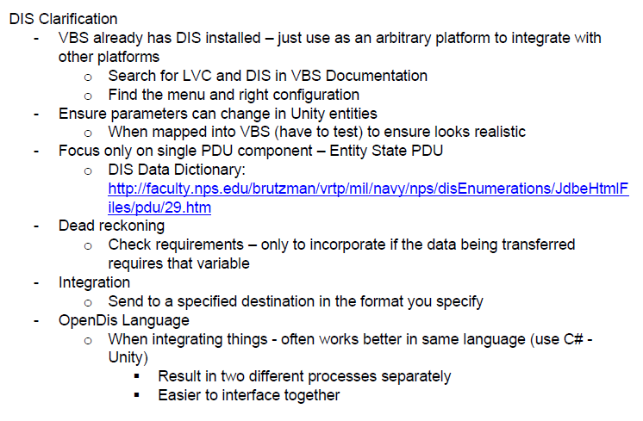
Our Issues
Main Issues:
Clarification required on DIS middleware configuration
This was brought up at the last client meeting where further guidelines were set with more explanation given to the integration aspect of this project
Further research was also completed and shared with the group
Client Meeting #2 Clarification

Slide 12
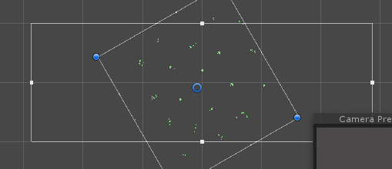
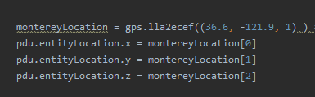
Current Progress
Unity: Boids simulation (flock of birds) Three Original Flocking Rules: Alignment Cohesion Separation | Two Additional Steering Rules: Obstacle Avoidance Goal-seeking “seek”
DIS in Unity:
OpenDIS – open source software in C# (easy integration?)
UnityDIS –possible established framework we can utilise https://sourceforge.net/projects/unitydis/

Slide 13
TASKS & TIMELINES
Schedule
Main Tasks - broken up into weeks
Weeks 2-3
Weeks 4-5
Weeks 6-7
Weeks 8-9
Weeks 10-11
Weeks 12-13
Week 14
Team Planning
Contracts and Charters
Development
Test & debugging
Project Delivery
SOFTWARS
13

Slide 14
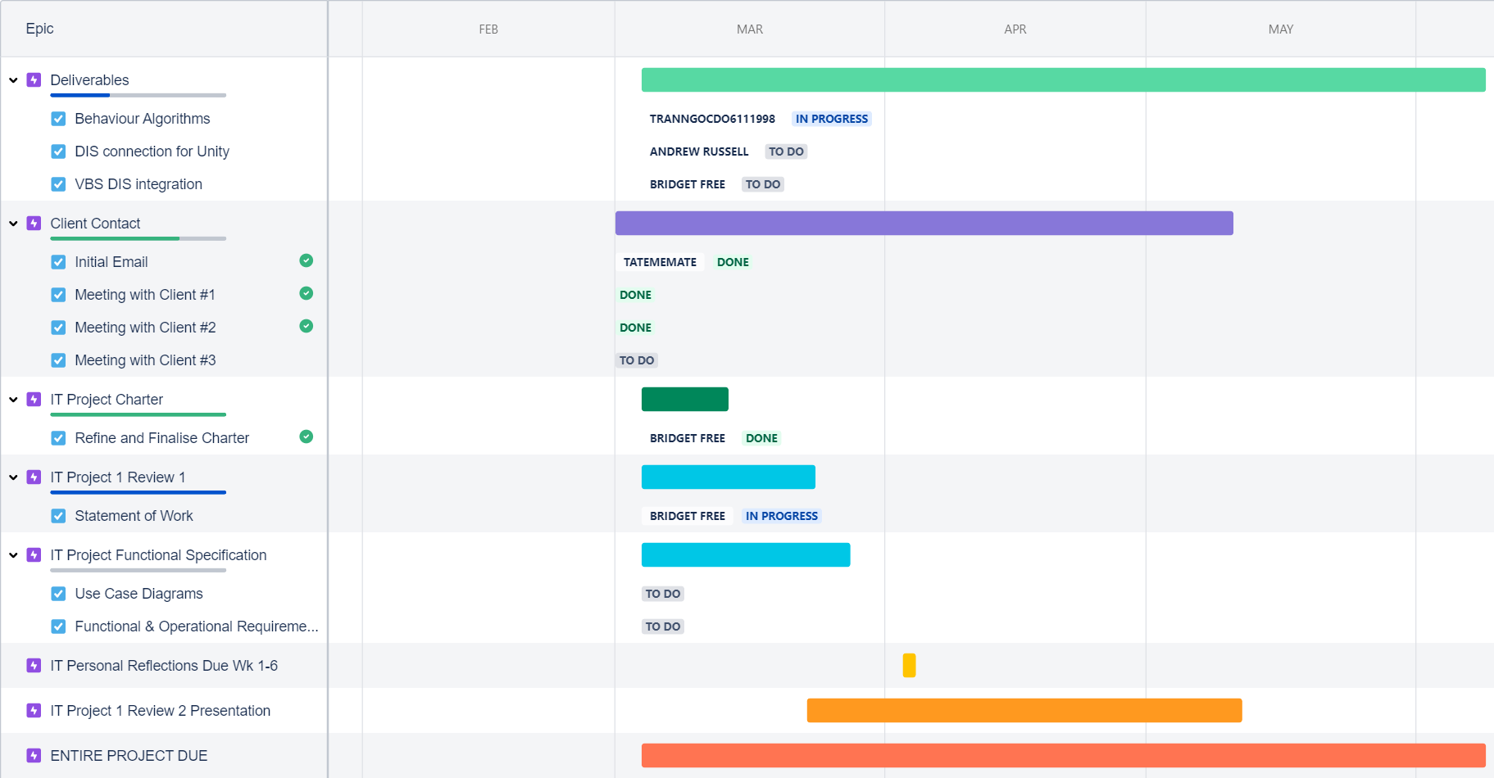

Slide 15
Milestones
Key Course Dates and Client Deliverables
Milestone | Details | Task Leaders | Estimated Delivery Date
Group Charter | Clarify team direction | Bridget (Approval by all) | 13 Mar
Basic Behavioural Algorithm | Boids (flocking behaviour) | Do and Andrew | 19 Mar
Statement of Work | Client contract with team | Bridget (Approval by all) | 23 Mar
Project Review 1 | Project progress update | All | 23 Mar
VBS Gateway | VBS DIS integration (network) | Bridget and Tate | 27 Mar
Functional Specification | Purpose, assumptions and requirements | Bridget (Approval and input by all) | 27 Mar
Configured middleware | Encode and inject traffic from Unity as a PDU entity (DIS) | Andrew | 20 Apr
Specific Behavioural Algorithms | Ground behaviours (crowds etc.) | Do | 30 Apr
Project Review 2 | Project progress update | All | 11 May
Simulated environment integration | VBS real-time updates from network | Bridget and Tate | 28 May
Customer Acceptance Report | Present deliverables and findings | All | 03 June
Project Due + Presentation | All artefacts, documentation and deliverables due | All | 08 June
SOFTWARS
15

Slide 16
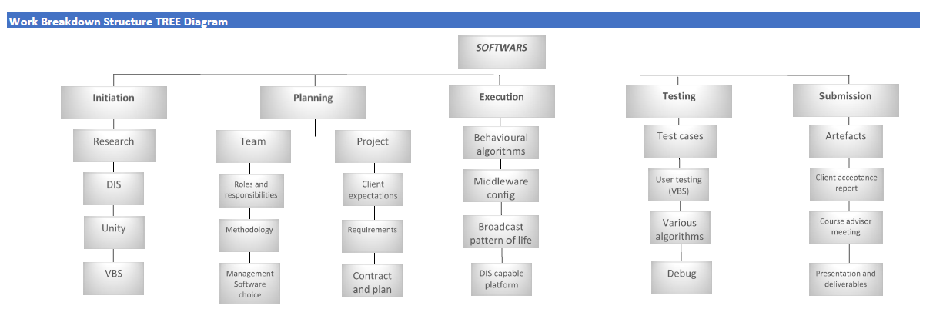

Slide 17
ARTEFACTS
Artefact 01 – Statement of Work
This document is a detailed description of the project’s work requirements. It defines deliverables and was agreed upon by our client (see Jira). The project charter was used as a foundational resource for this artefact.
Key Artefacts and Overviews
1
Artefact 02 – Resource Log
This google doc is regularly updated to ensure resources are shared amongst the team and everyone can update themselves.
2
3
Artefact 03 – Gantt Chart
This Gantt Chart follows our milestone timeline with further detail regarding the testing and final project delivery.

Slide 18
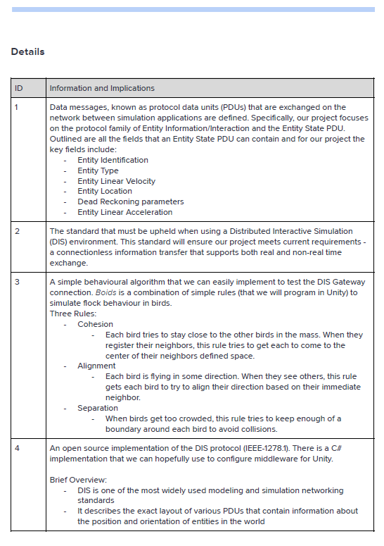
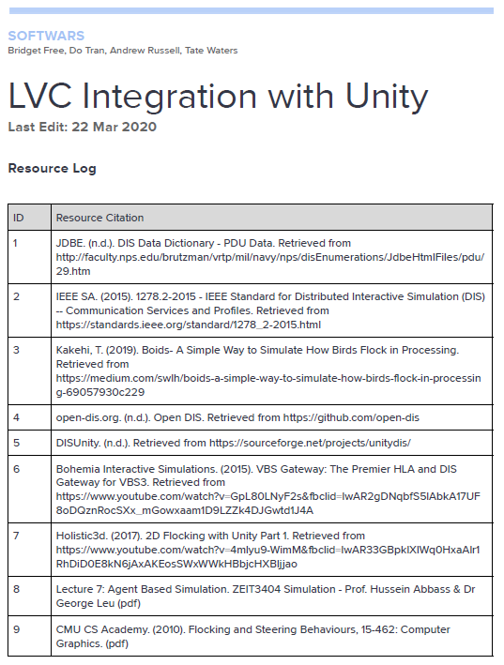
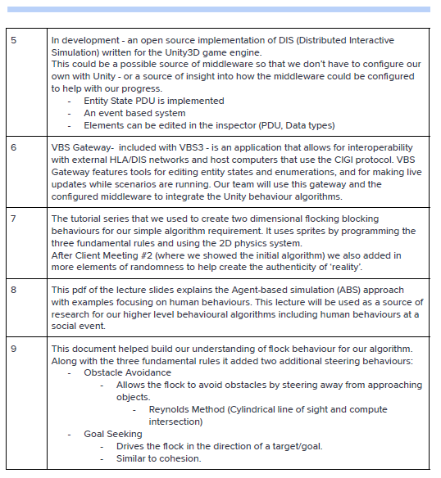
Resource Log

Slide 19
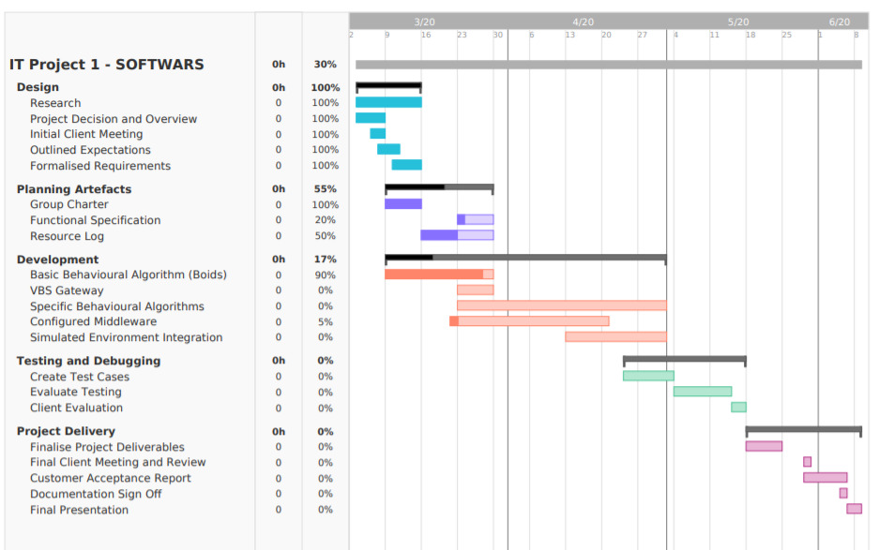
Gantt Chart

Slide 20
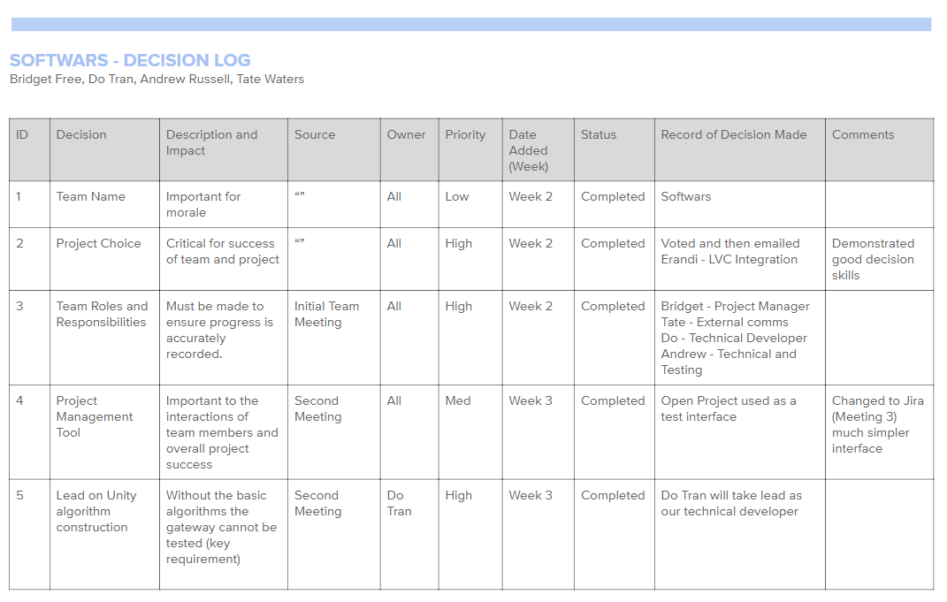
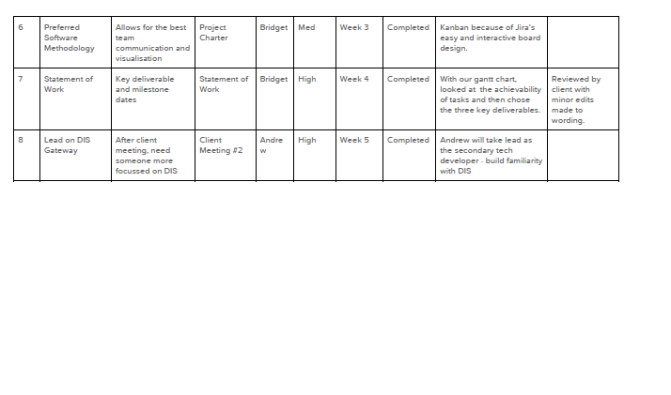
Decision Log

Slide 21
Other Artefacts
Project Charter
Client Meeting Minutes
Team Meeting Notes
Functional Specification (Draft – In Progress)
See both Jira and Github for full details.
https://softwars.atlassian.net/jira/software/projects/SOF/boards/1/roadmap
https://github.com/dotran98/IT-PRoject-1

Slide 22
Conclusion
Summary
At the end of this project we will have a presentable deliverable in Unity that accurately injects NPC traffic into any number of simulators connected to the network (via DIS gateway).
SOFTWARS
22

Slide 23

Any Questions…

